Slide 1

Operators

Slide 2
Python Operators
1.Arithmetic operators
2.Assignment operators
3.Logical operators
4.Identity operators
5.Membership operators
6.Bitwise operators
7.Relational operator
8.Operator Precedence
Evaluating expression
Type casting

Slide 3
1.Arithmetic Operators
Arithmetic operators perform the common mathematical operation on the numeric operands.
The arithmetic operators return the type of result depends on the type of operands, as below.
If either operand is a complex number, the result is converted to complex;
If either operand is a floating point number, the result is converted to floating point;
If both operands are integers, then the result is an integer and no conversion is needed.

Slide 4
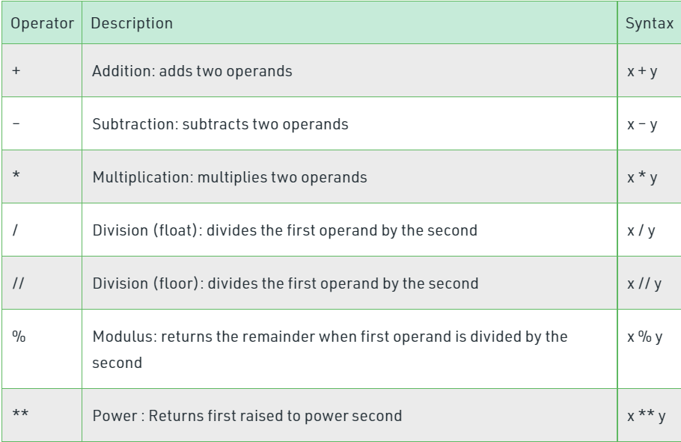

Slide 5
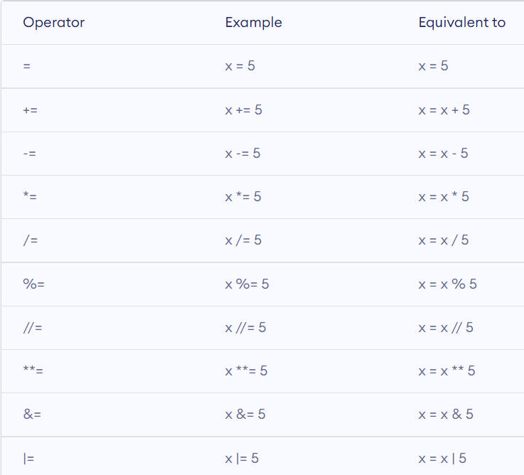
2.Assignment operator
The assignment operators are used to assign values to variables. The following table lists all the arithmetic operators in Python:

Slide 6
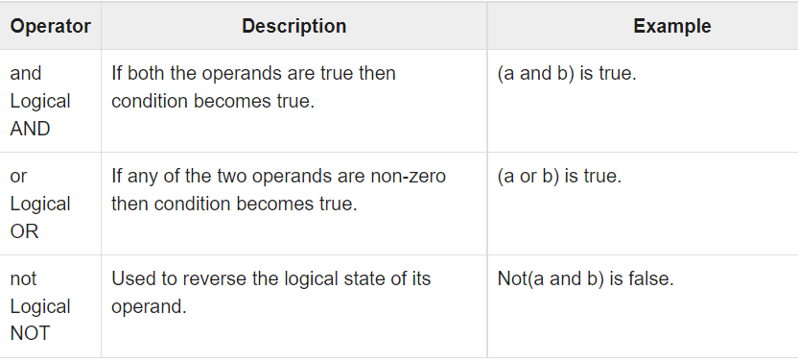
3.Logical Operator
The logical operators are used to combine two boolean expressions. The logical operations are generally applicable to all objects, and support truth tests, identity tests, and boolean operations.

Slide 7
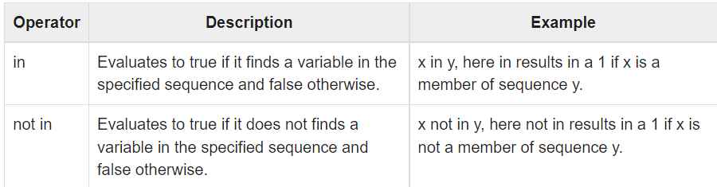
4. Python Membership Operators
Python’s membership operators test for membership in a sequence, such as strings, lists, or tuples.

Slide 8
5. Python Comparison Operators
These operators compare the values on either sides of them and decide the relation among them. They are also called Relational operators.

Slide 9
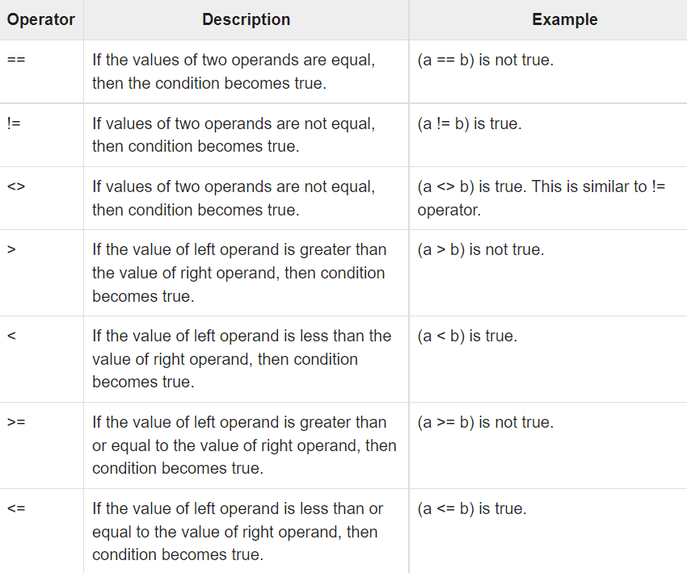

Slide 10
7. Identity operator
Is and Is not
is’ operator – Evaluates to true if the variables on either side of the operator point to the same object and false otherwise.
x = 5
if (type(x) is int):
print("true")
else:
print("false")

Slide 11
‘is not’ operator – Evaluates to false if the variables on either side of the operator point to the same object and true otherwise.
x = 5.2
if (type(x) is not int):
print("true")
else:
print("false")

Slide 12
8. Bitwise operator
In Python, bitwise operators are used to performing bitwise calculations on integers.
The integers are first converted into binary and then operations are performed on bit by bit, hence the name bitwise operators.

Slide 13
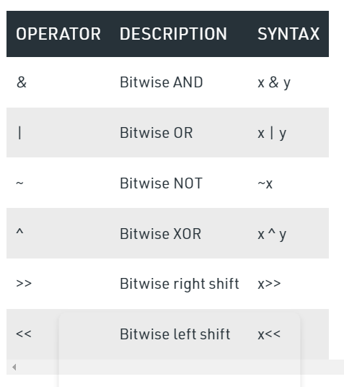

Slide 14
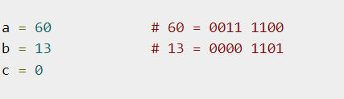
Example :

Slide 15
Bitwise And
Bitwise OR
Bitwise And :
1110011
110000
And (110000) (Multiplying the bits)

Slide 16
Bitwise OR operator
OR
11100111001
00011001111
Result : 11111111111

Slide 17
Evaluating expression - Using eval function
evaluate = 'x*(x+1)*(x+2)'
print(evaluate)
print(type(evaluate))
x = 3
print(type(x))
expression = eval(evaluate)
print(expression)
print(type(expression))

Slide 18
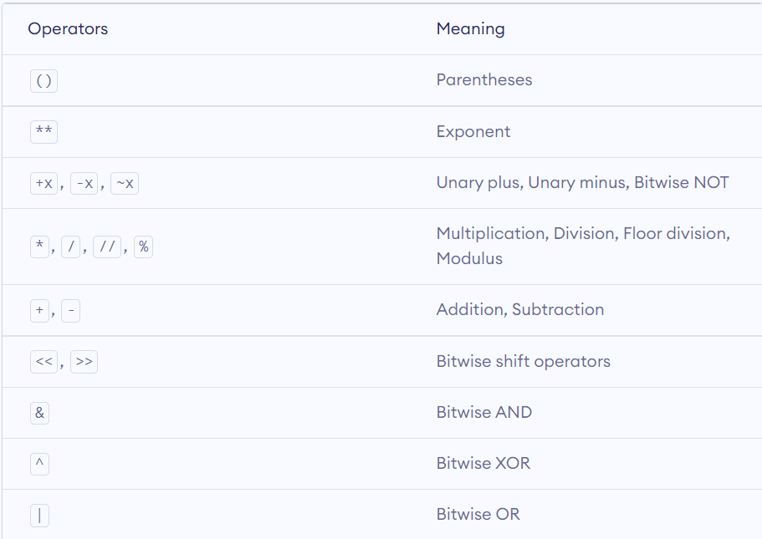
Operator Precedence

Slide 19
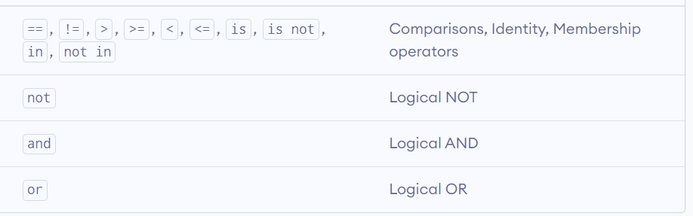
continue

Slide 20
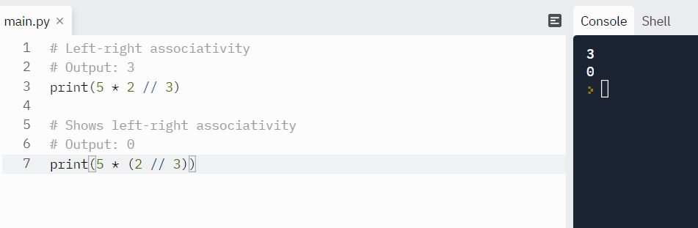
Example

Slide 21
